Slide 1

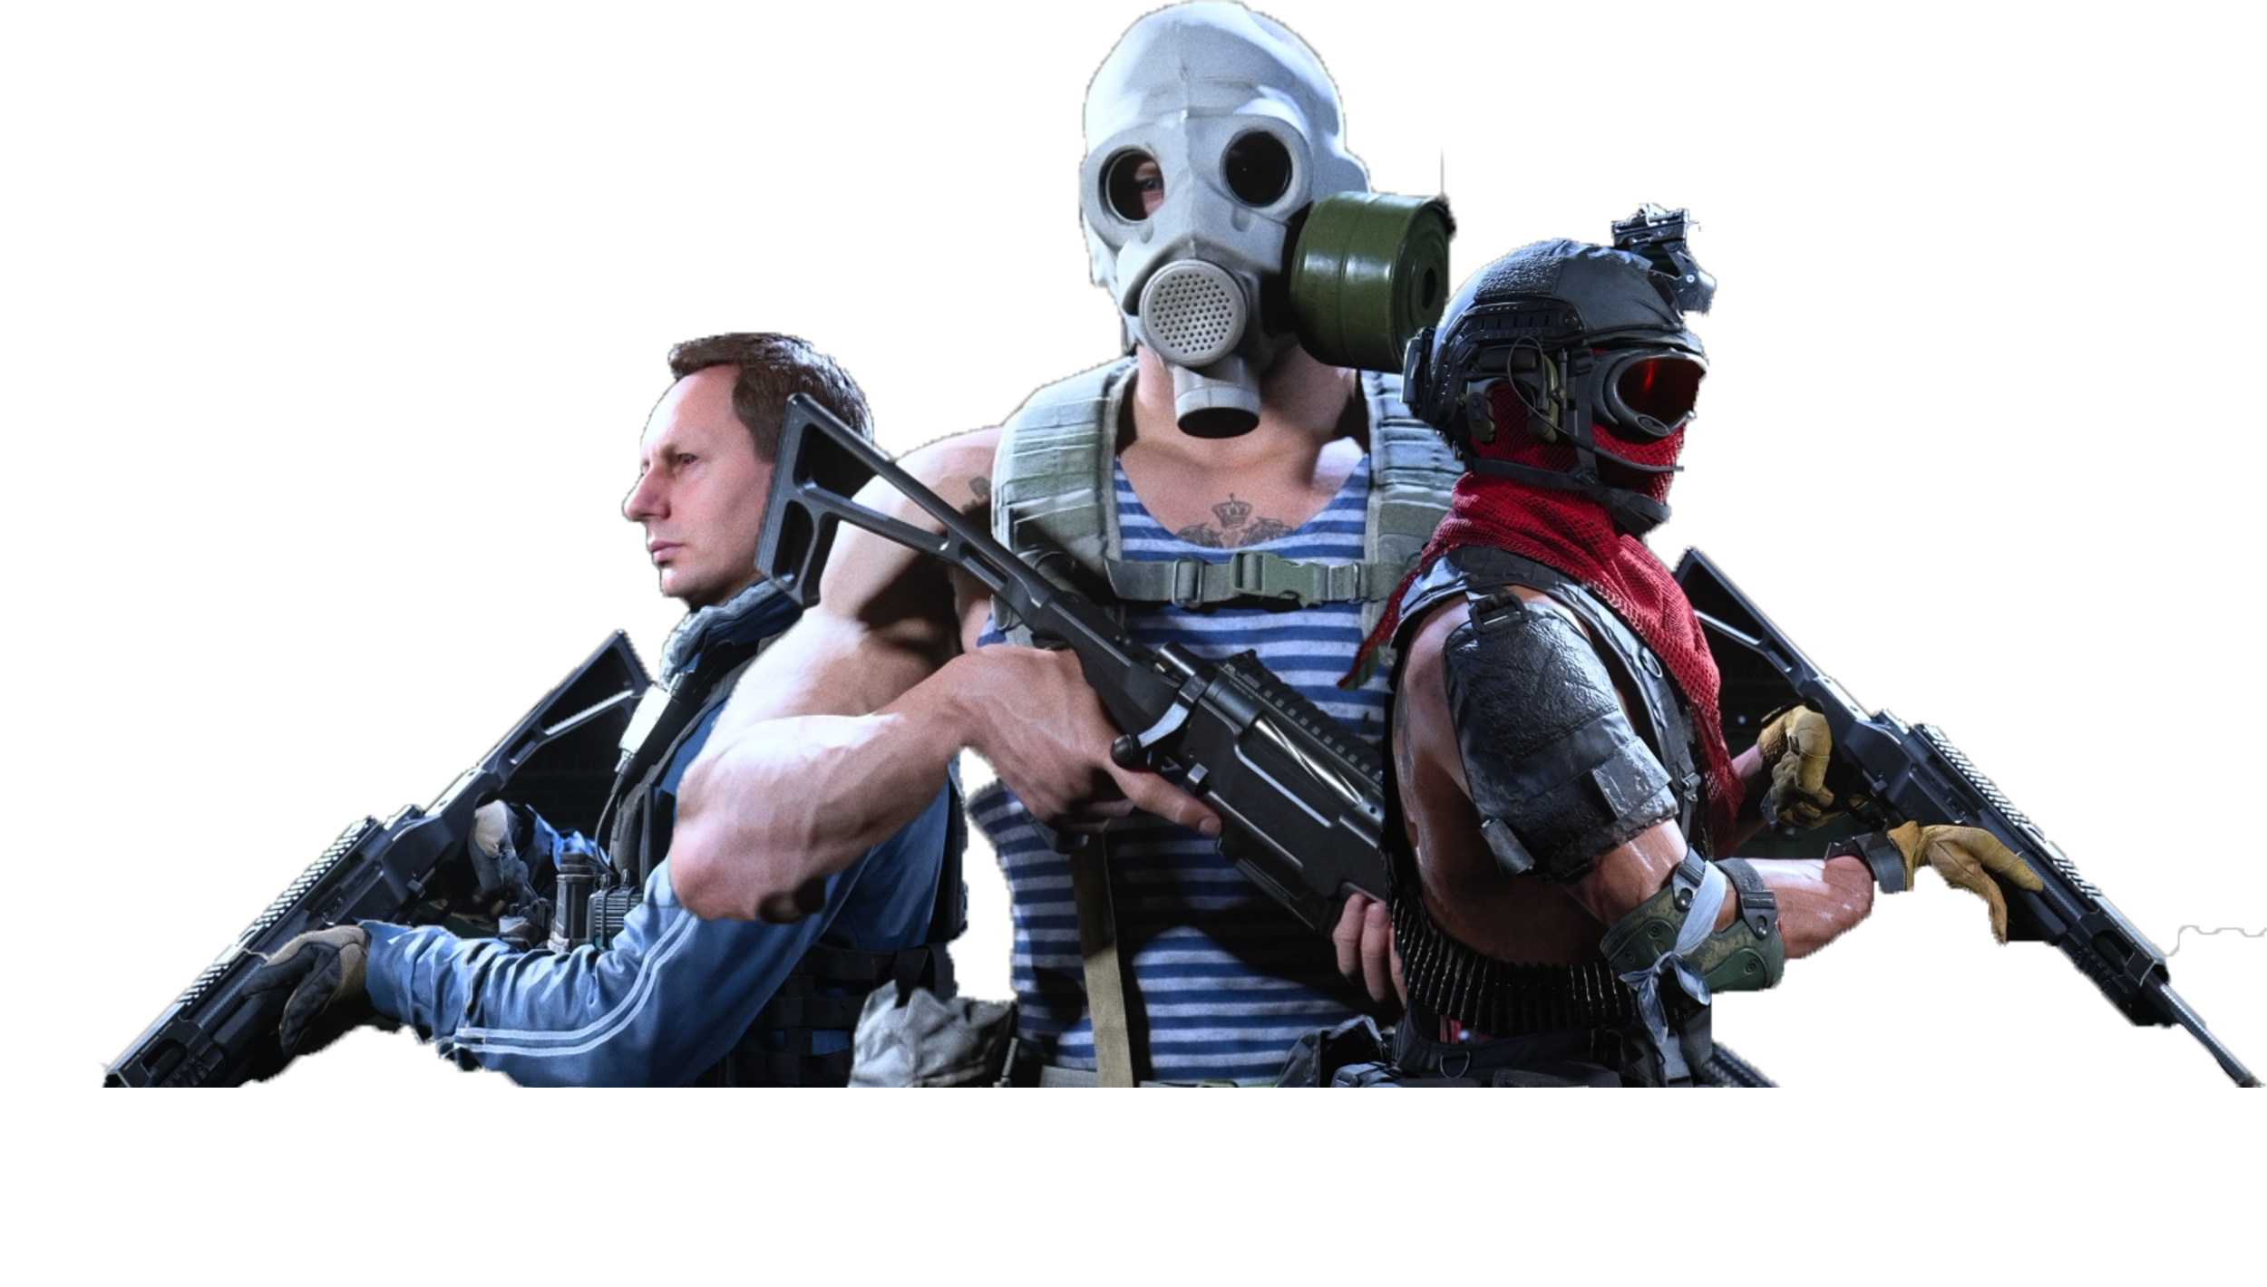

Fan Analysis
Sponsor appeal Examined
Hult – NLP
Max Lembke
15.01.2021

Slide 2
Agenda
Agenda
Background & Problem
Methodology
Overview
Engagement
League
Sponsors
Polarity
Recommendations
Limitations & Future Research

Slide 3
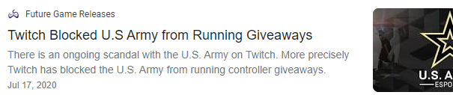
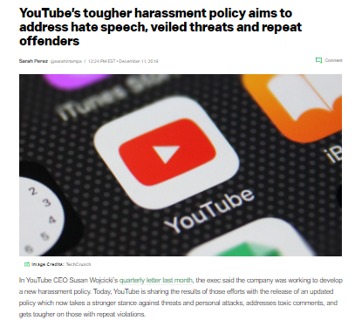
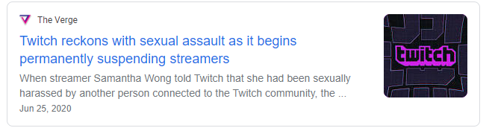
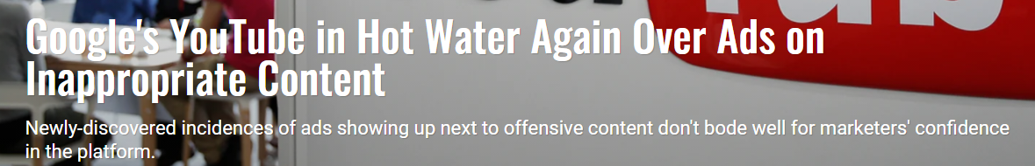
Background and Problem
Changes to League in 2020
Major shift for e-sports
Large sponsors for small league & teams
Sponsors have become increasingly concerned
Shifts in advertising placement
Fan engagement & attitude needs to be considered
League needs to ensure positive environment

Slide 4

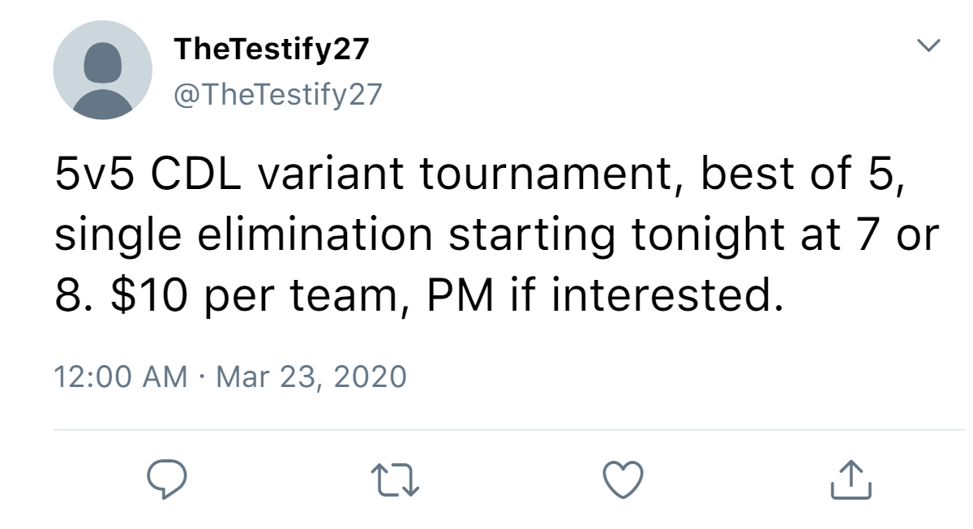
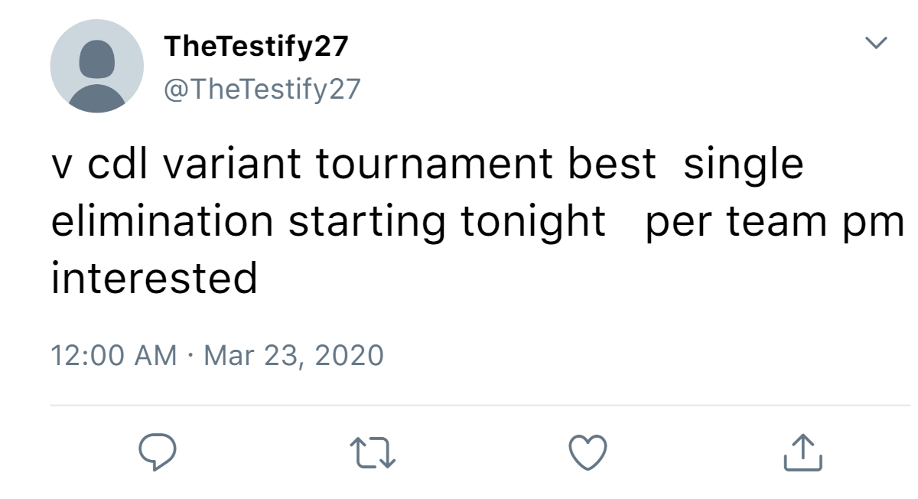
Methodology: Data
Combination of team’s and player’s fans tweet (~2.4 million)
Double tweets excluded (~1.9 million)
Timeframe from 10/28/19 – 09/06/20 (~377k)
Hashtags appended to text
Text cleaned of symbols, numbers, lowercase etc.
Little stop words removed due to “gaming speak”
Accounted for different COD variants & swear words
Cleaned and features re-appended
Team names maintained
Example
Sparse Terms Removed in many of the conducted analysis

Slide 5
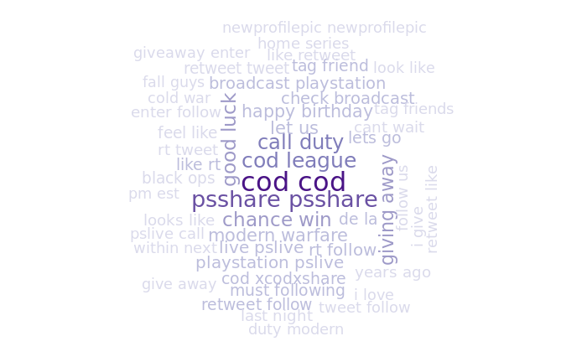
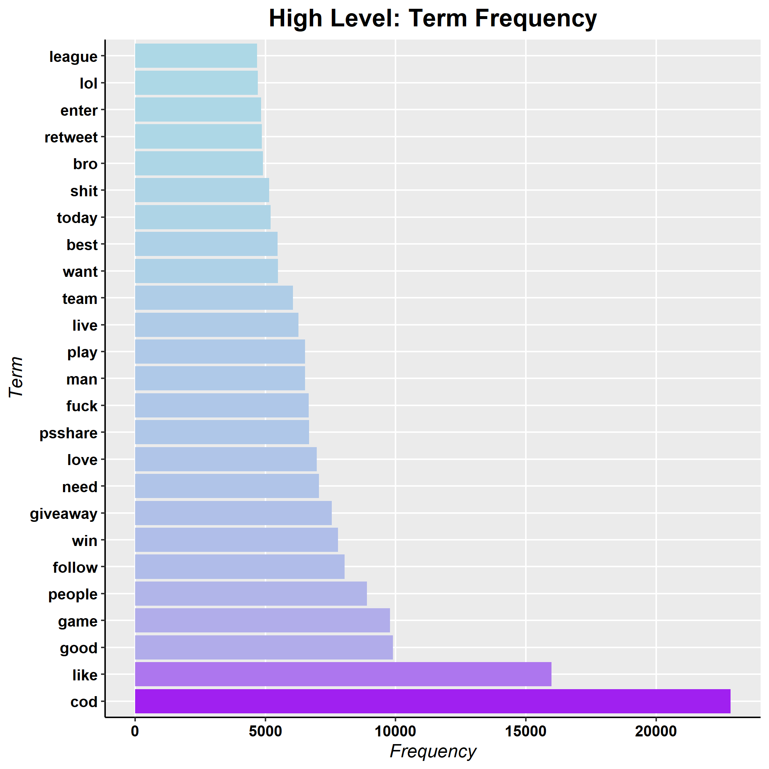
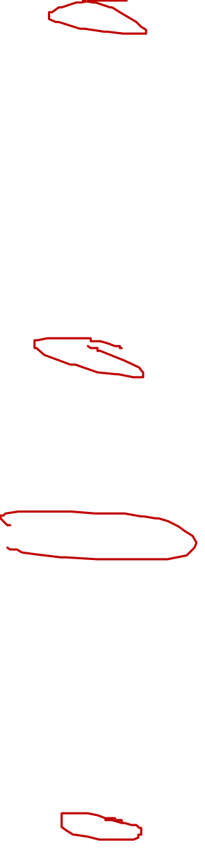
Overview
Examination of frequent terms across the entire dataset (excluding sparse terms)
Followers engage vividly with the game and subject
PlayStation topics highly relevant
Not only COD:Cold War popular
Frequent occurrence of swearwords might constitute problem, demands further investigation

Slide 6
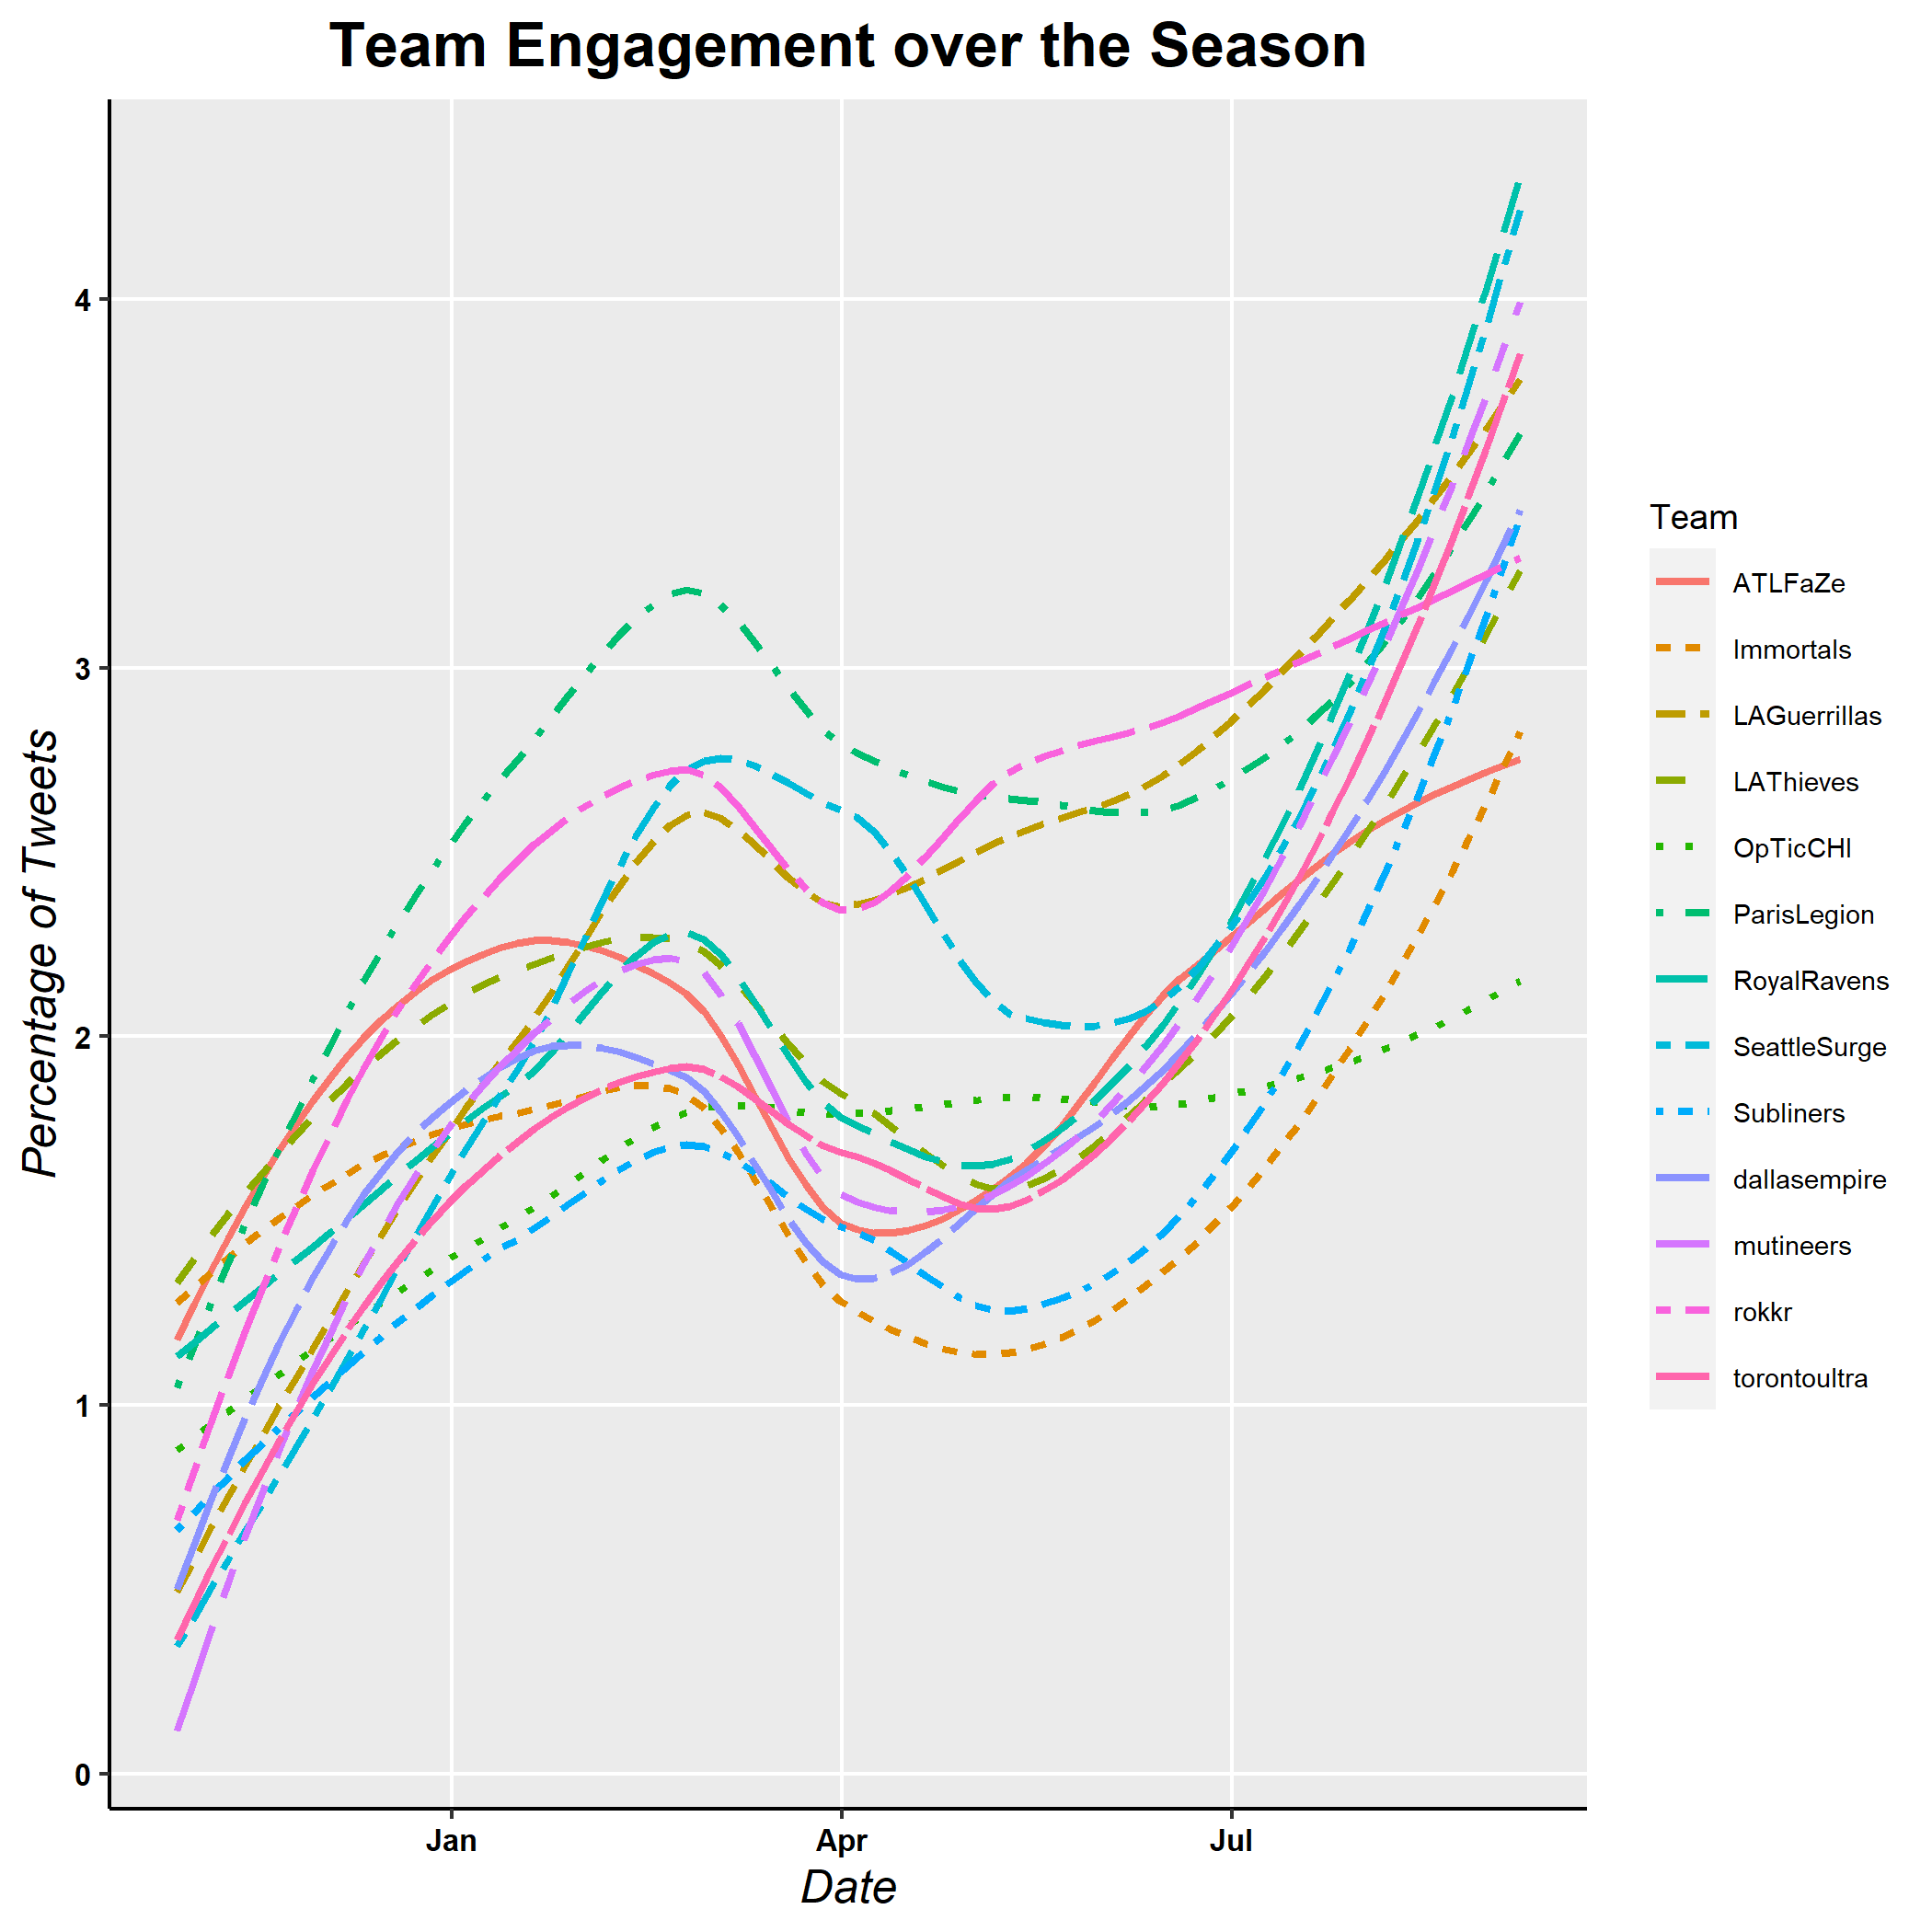
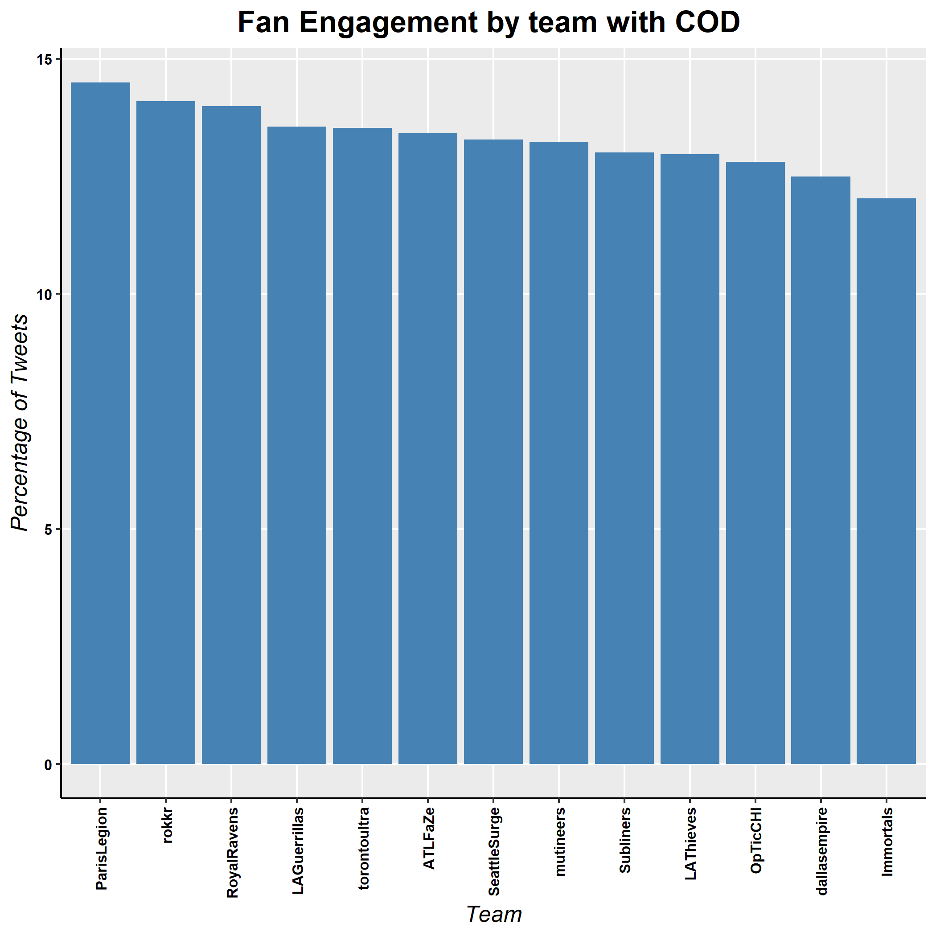
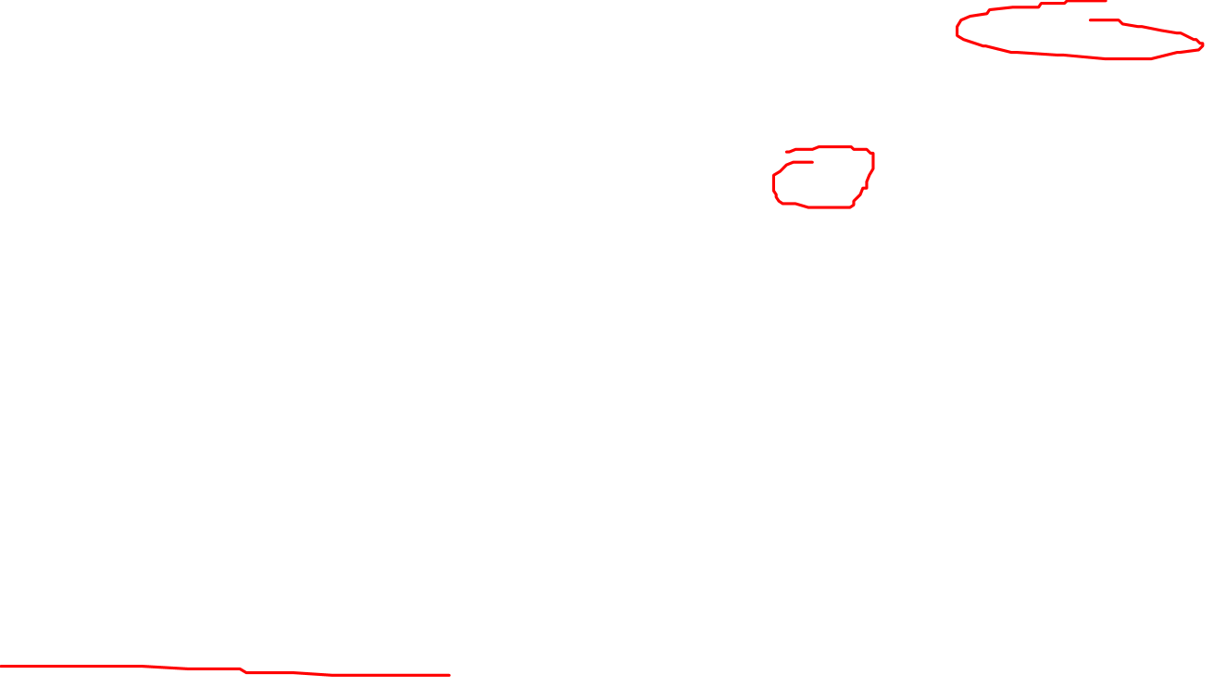
Engagement: Overview
Fans are engaged at a similar percentage across teams with only slight differences
Approximately 14.5% - 12% engagement with COD
League engagement non-constant
Ramp up in pre-season and finals
Non-game times experience dips
Volatility may scare sponsors off
Season performance not necessarily determining factor

Slide 7
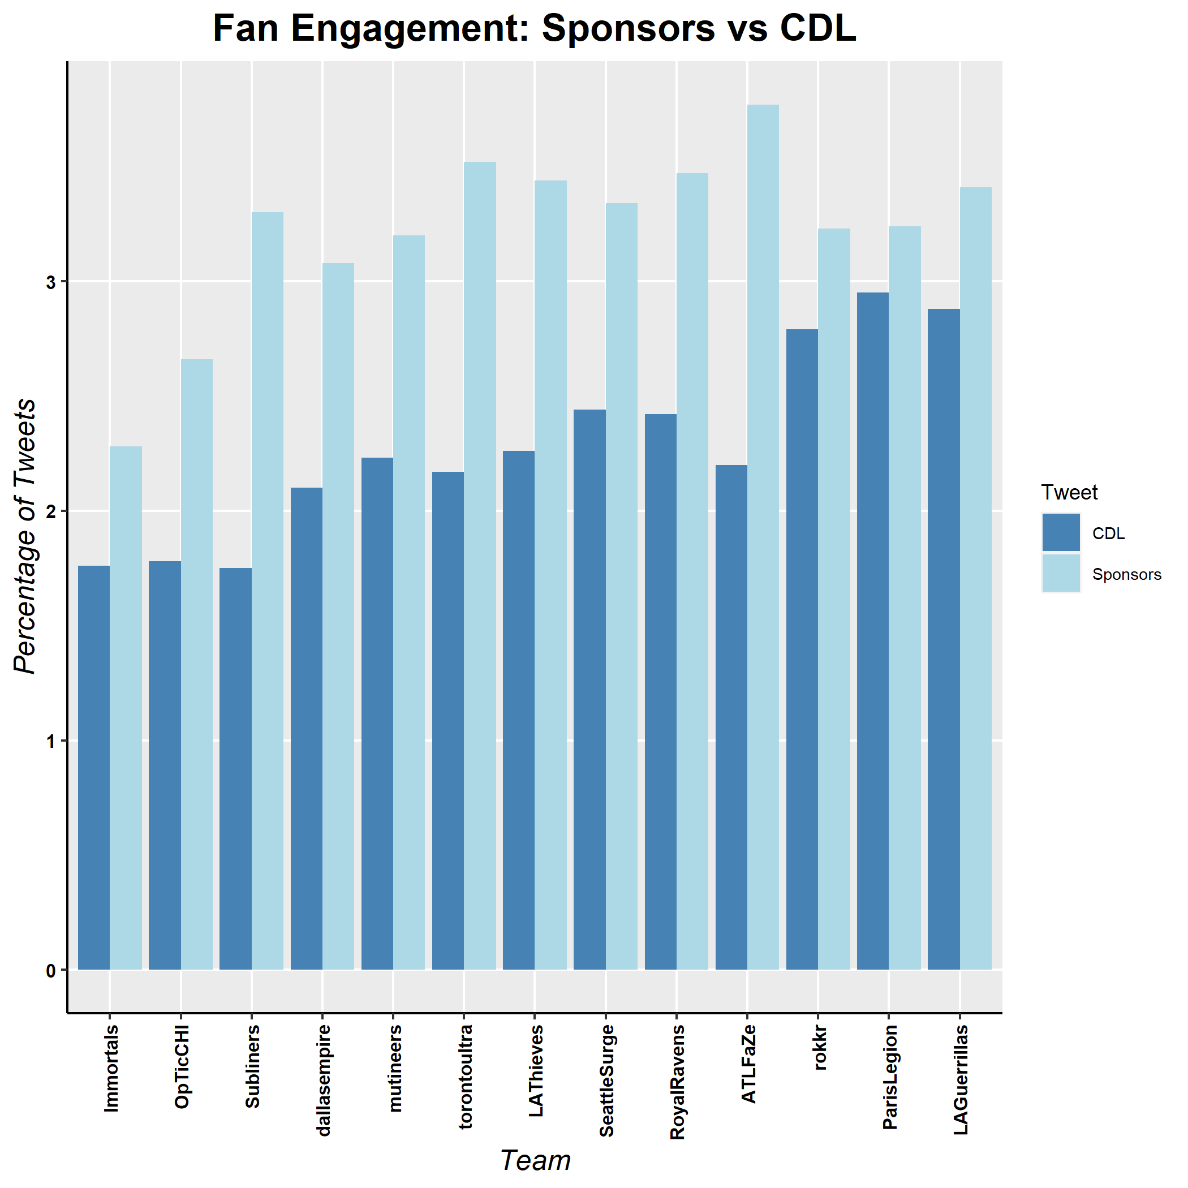
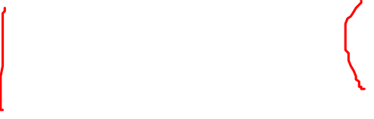
Engagement: Sponsors
Key Sponsors: Astro, Playstation, ScufGaming Controllers, GameFuel & US Military
Engagement with CDL & Sponsors low when compared with COD
Successful teams & corporate teams more engaged with sponsors
More engagement with CDL does not lead to more engagement with Sponsors
Classical engagement is not representative to measuring engagement with sponsors

Slide 8
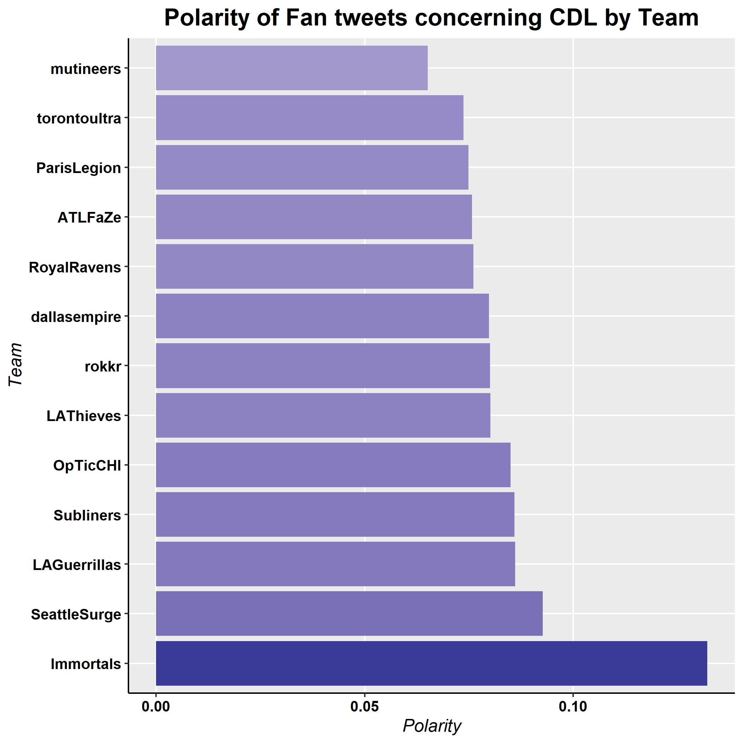
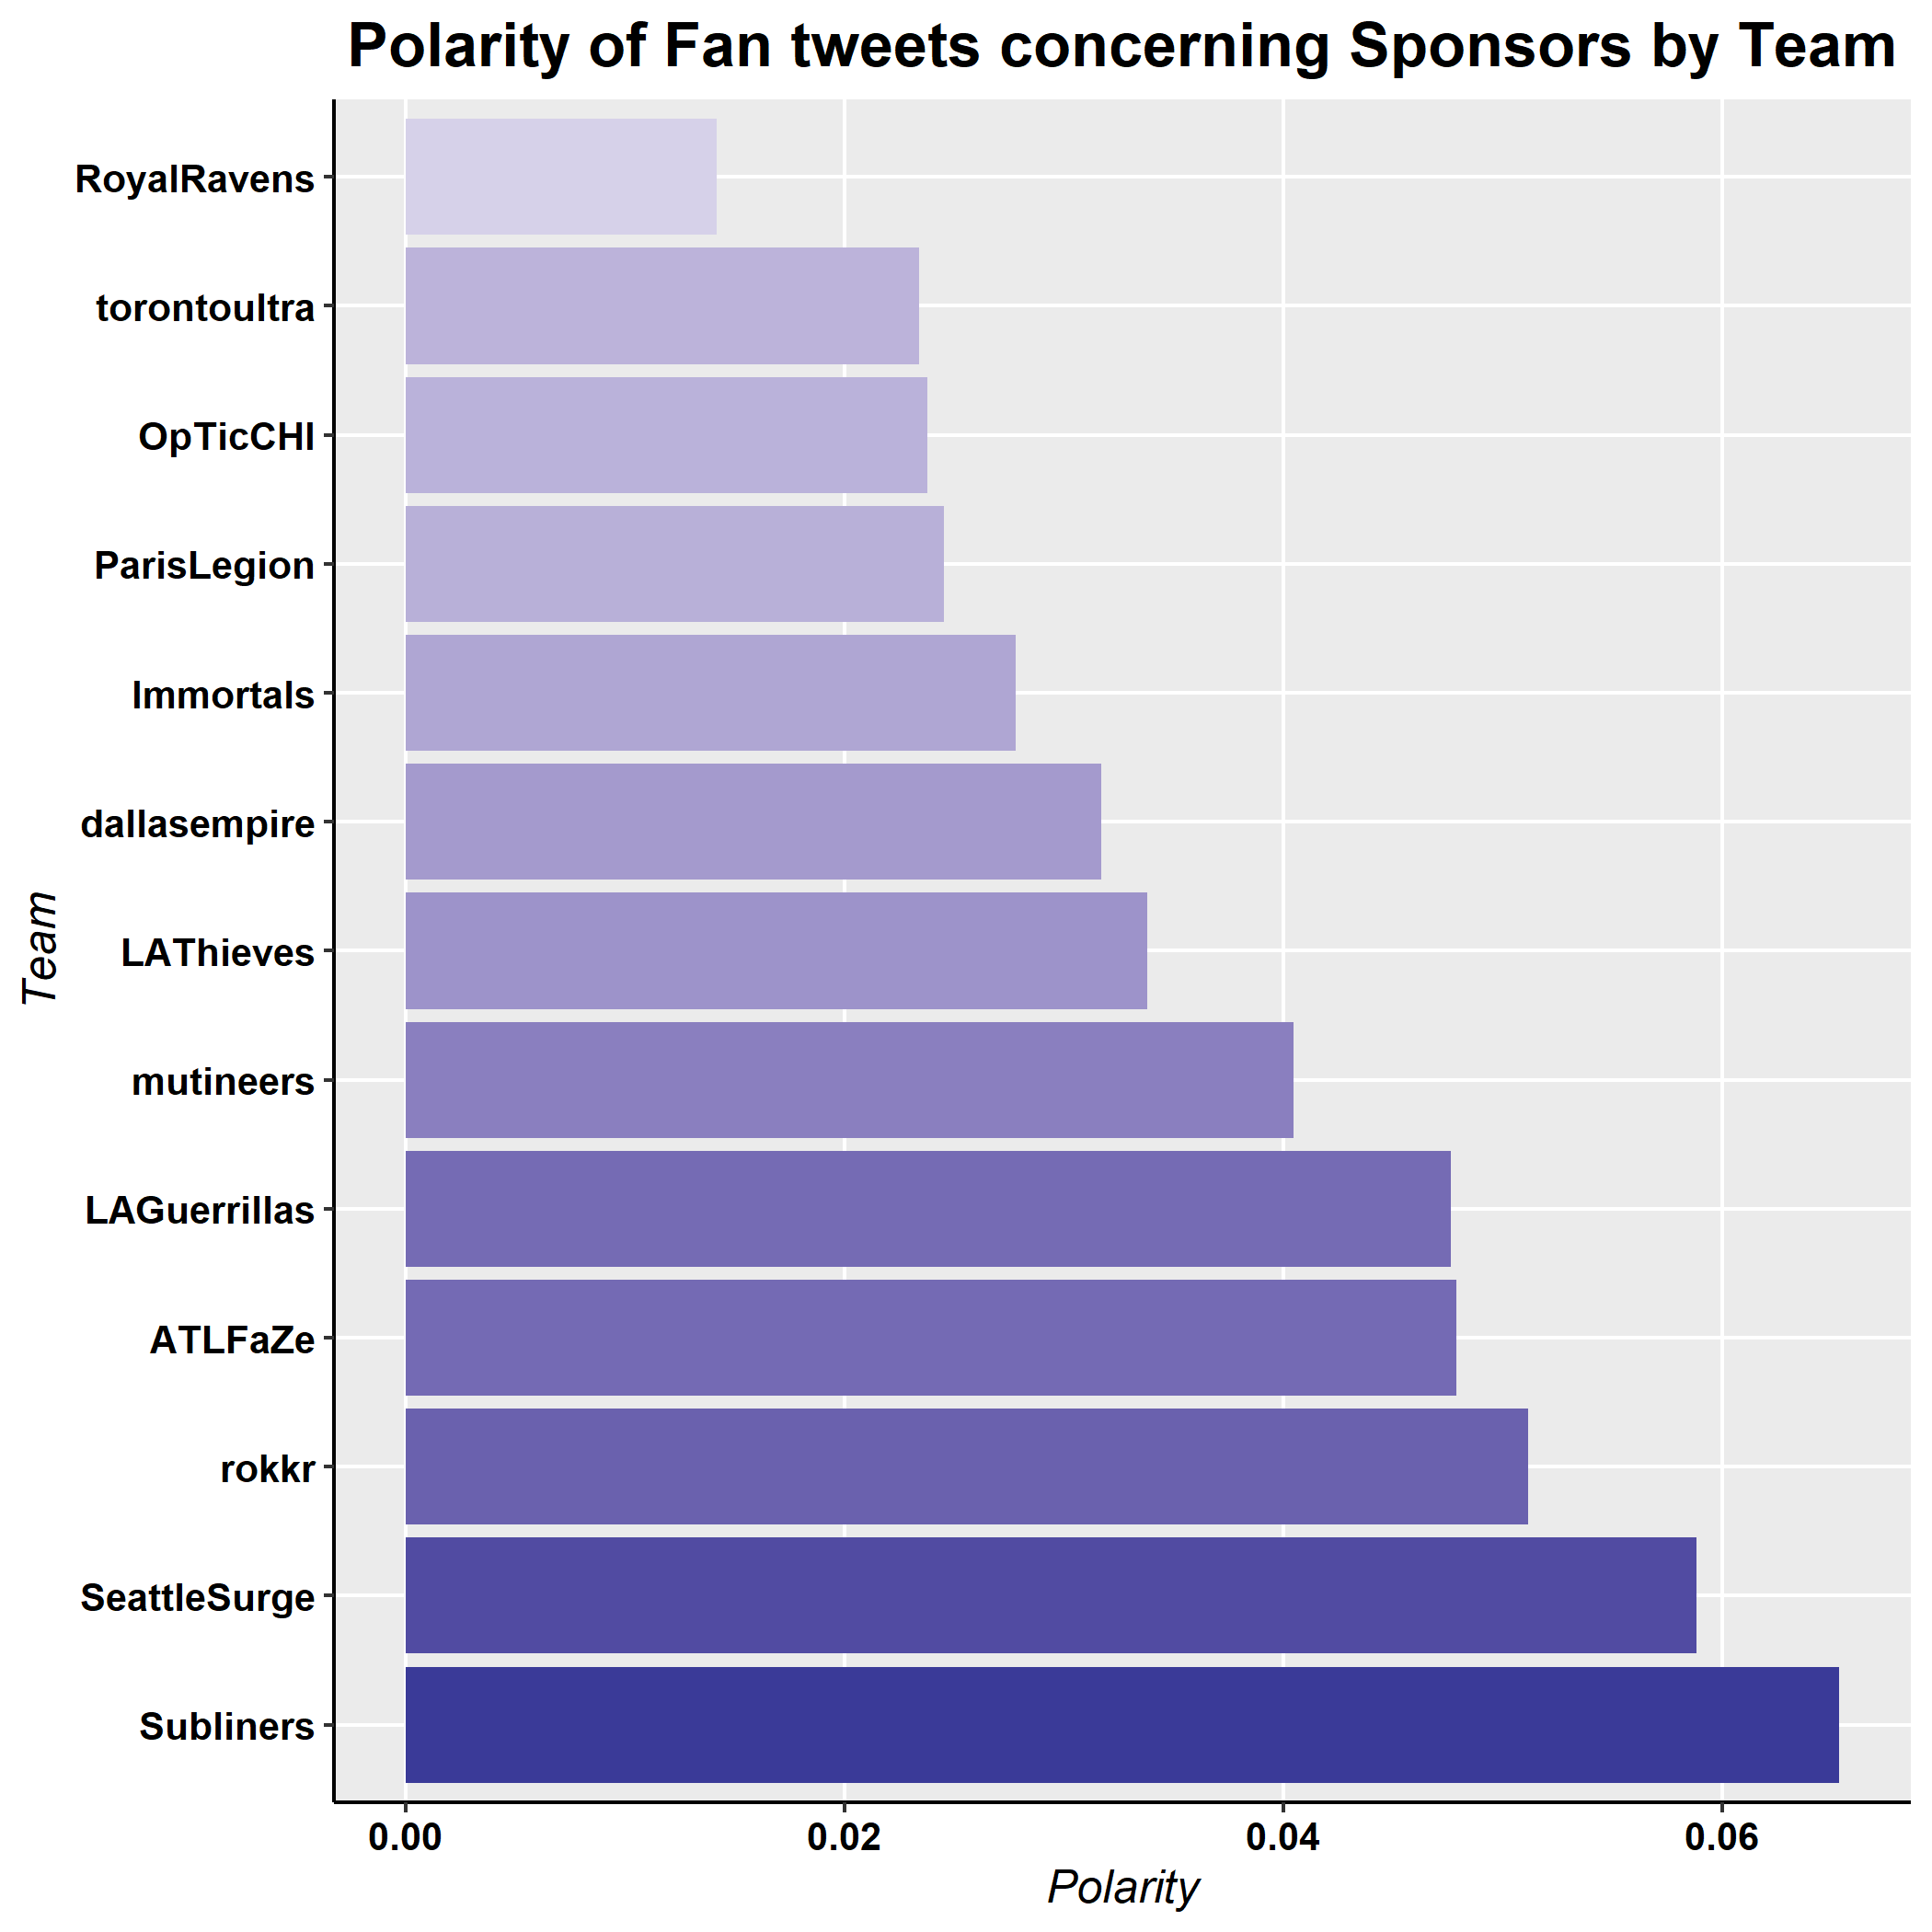
Polarity
Polarity in general largely neutral
Only minor differences between teams
Popular idea of a toxic gaming culture is not visible
Little differences in polarity towards sponsors or league
Activision still generates some negative sentiments in the community, but less than expected

Slide 9
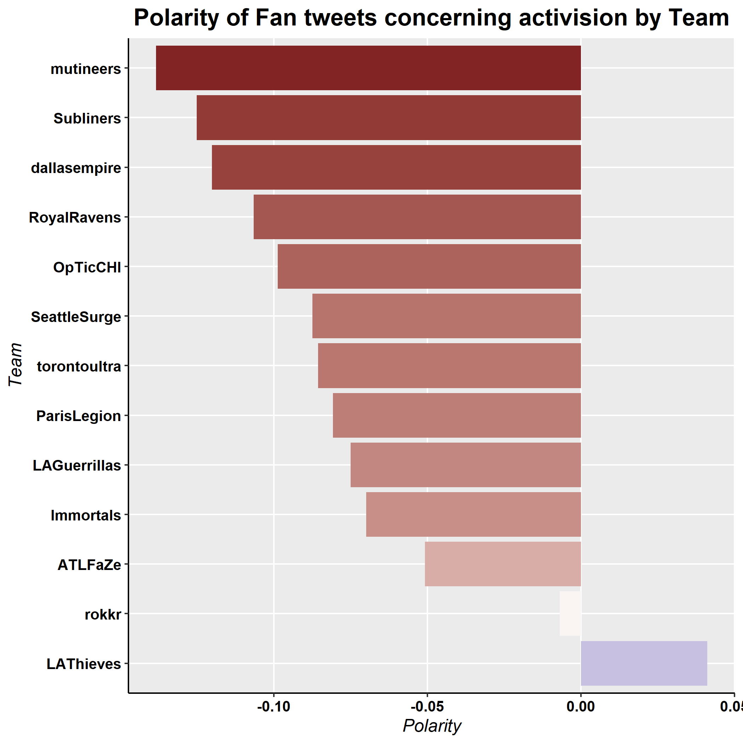
Polarity
Polarity in general largely neutral
Only minor differences between teams
Popular idea of a toxic gaming culture is not visible
Little differences in polarity towards sponsors or league
Activision still generates some negative sentiments in the community, but less than expected

Slide 10
Recommendations
1. Data Driven Communication
The CDL needs to differentiate itself towards other gaming communities and incidents, use these insights to highlight to sponsors that the community is not negative and dangerous. This will attract non-gaming sponsors.
2. Improve engagement with CDL
The community is very engaged with COD, but CDL falls short. CDL content can be featured more prominently in game loading screens. Further, “old” COD games remain popular, and inclusion could boast engagement.
3. Utilize incentives in “low-times”
Engagement various greatly throughout time, but community very eager to engage with giveaways etc. – conduct these actively in off-season.

Slide 11
Limitations AND FUTURE RESEARCH
Changes in teams created friction in the community and might affect effect analysis
Analysis can be improved after comparing to other e-sports and seasons
Engagement with sponsors over time
Considering sponsors giveaways could generate interesting insights but more data would be needed

Slide 12
Thank you

